Slide 1
SERTS Music Player Project
McKenna Gameros

Slide 2
Overview
Project Review
GUI
State Machine
Main Functionality
Limitations
Conclusion
Demonstration

Slide 3
Project Review
Create code for a music player using Visual Basic and C
Use the STM32F4-Discovery board as the main controller
Allow for playing, pausing, resuming, and stopping files
Extra: Show which file is currently playing

Slide 4
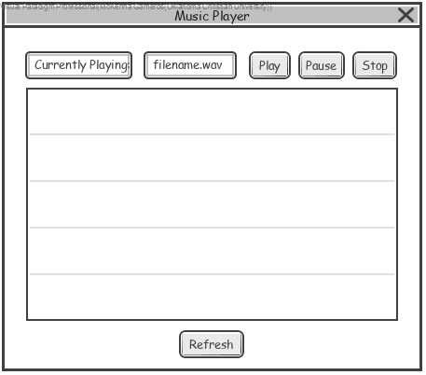
GUI
Currently Playing Text
List of Files on USB
Four Buttons
Play
Pause
Stop
Refresh

Slide 5
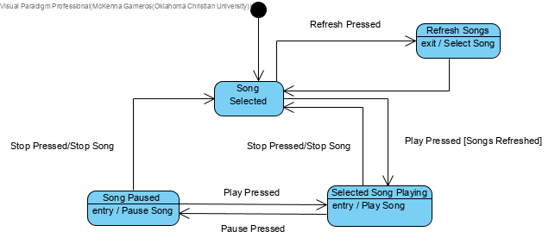
State Machine

Slide 6
Main Functionality
Plays selected song
Pauses currently playing song
Stops currently playing song
Shows name of currently playing song
Randomizes selection on startup or when stop is pressed

Slide 7
Limitations
Cannot play a song after the other finishes
Does not resume
Randomizer sometimes will not work

Slide 8
Conclusion
Music player functions satisfactorily
Learned a lot
Proud of work

Slide 9
Demonstration

